Slide 1

MADAN MOHAN MALAVIYA UNIVERSITY OF TECHNOLOGY
GORAKHPUR
PIXEL PEN (A HIGH-PERFORMANCE FULL-STACK PLATFORM)
Presented by:
AHMAD FARAZ ANSARI (2023073006) ANJALI CHAUDHARY (2023073010)
SHUBHAM (2023073062)
Under Supervision By:
DR. JAY PRAKASH
PROFESSOR
DEPT. of ITCA

Slide 2
Contents
Abstract
Problem Statement
Need
Methodology
Project Screenshots
Advantages
Limitations
Future Work
References

Slide 3
Abstract
Pixel Pen is a modern, full-stack blogging platform developed using the MERN stack (MongoDB, Express.js, React.js, Node.js). It offers a smooth, user-friendly, and scalable environment for creating, publishing, and managing blog content.
The application supports multiple user roles — Admin, Editor, Registered User, and Guest — each with defined privileges.
Pixel Pen features secure authentication via JWT, RESTful API services, a responsive frontend with Tailwind CSS, rich-text editing, a comment system, post categorization, and an admin dashboard.

Slide 4
Problem Statement
Modern bloggers require scalable, secure, and easy-to-use platforms, but existing solutions often remain expensive, rigid, or outdated and lacks SEO optimization.
The challenge is to create a system that provides:
A seamless experience for writers to create, edit, and manage their blogs
Secure access control and role-based privileges
Scalable architecture to accommodate growing user bases
Pixel Pen addresses these challenges by building a powerful, full-stack, open platform that developers can extend, customize, and deploy efficiently.

Slide 5
Need
Simplify content publishing for bloggers and writers.
Train developers with real-world full-stack development practices like SEO optimization.
Deliver a responsive, secure, and high performant modern web platform.
Secure login and role-based access management.
Modern web standards and technology integration (MERN stack)

Slide 6
Methodology
Requirement analysis.
Technology stack selection.
Database design.
Server-side development (Node.js and Express.js)
Client-side development (React.js, Tailwind CSS and Flowbite React)
User authentication.
UI/UX design.
Deployment.
Performance optimization.
Monitoring and Maintenance

Slide 7
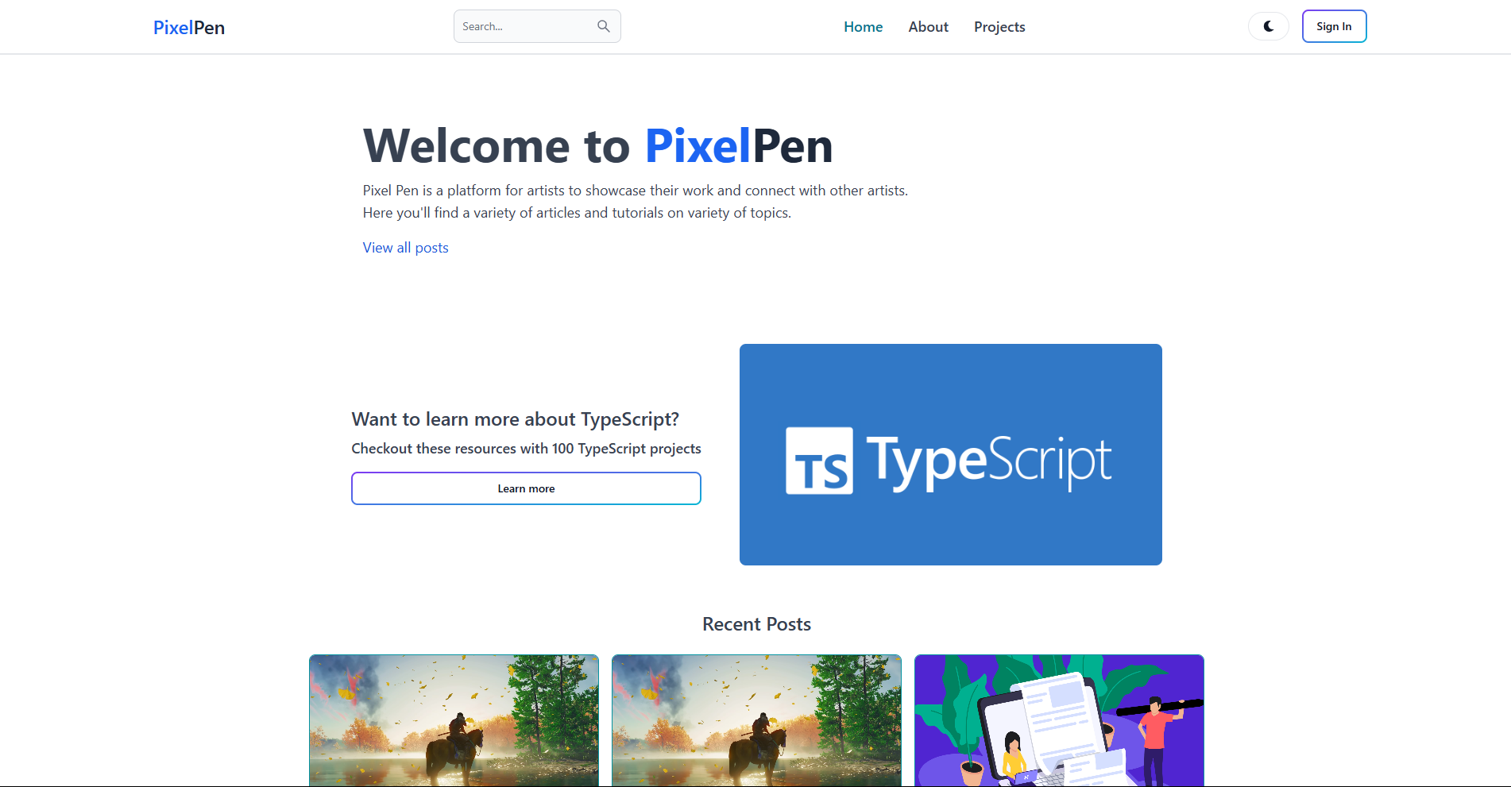
Results (Home Page)

Slide 8
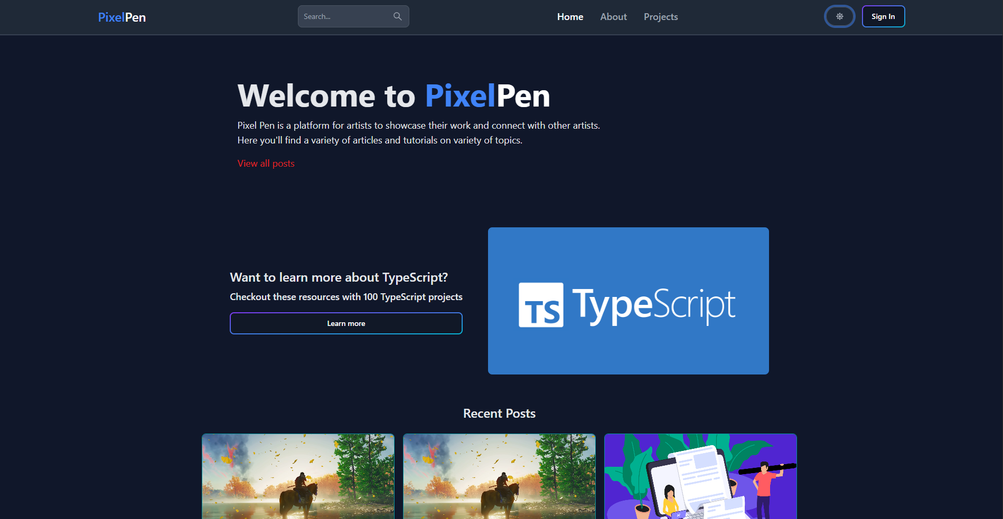
Home Page (Dark Mode)

Slide 9
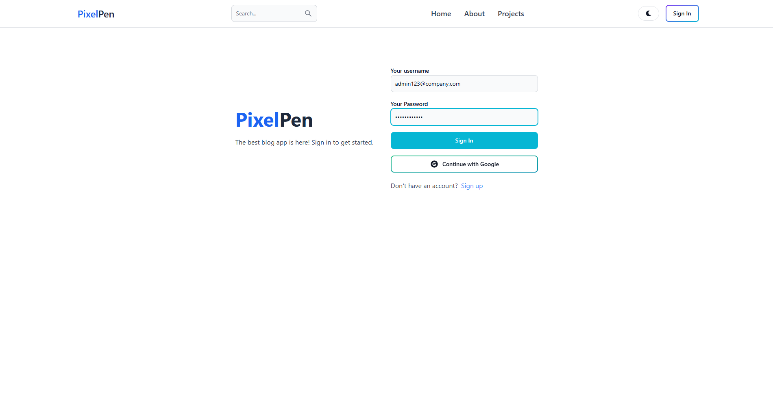
Log-In Page

Slide 10
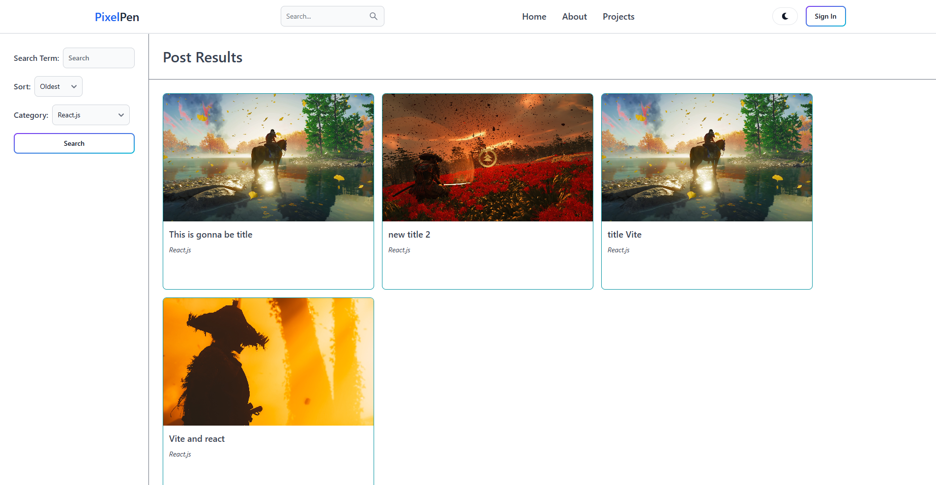
Search And Filter Page

Slide 11
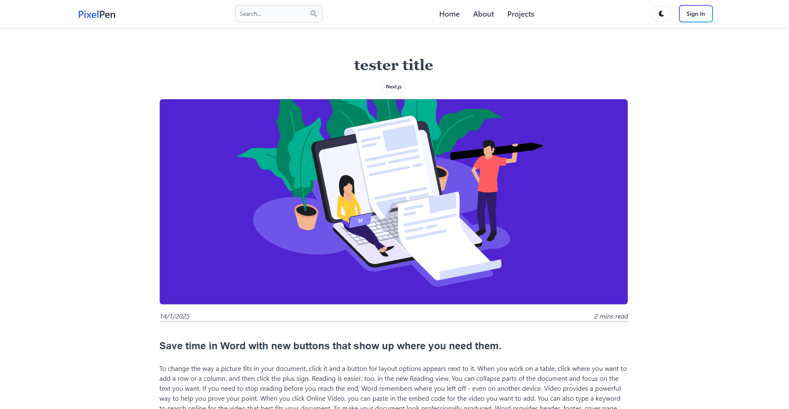
Blog Article Page

Slide 12
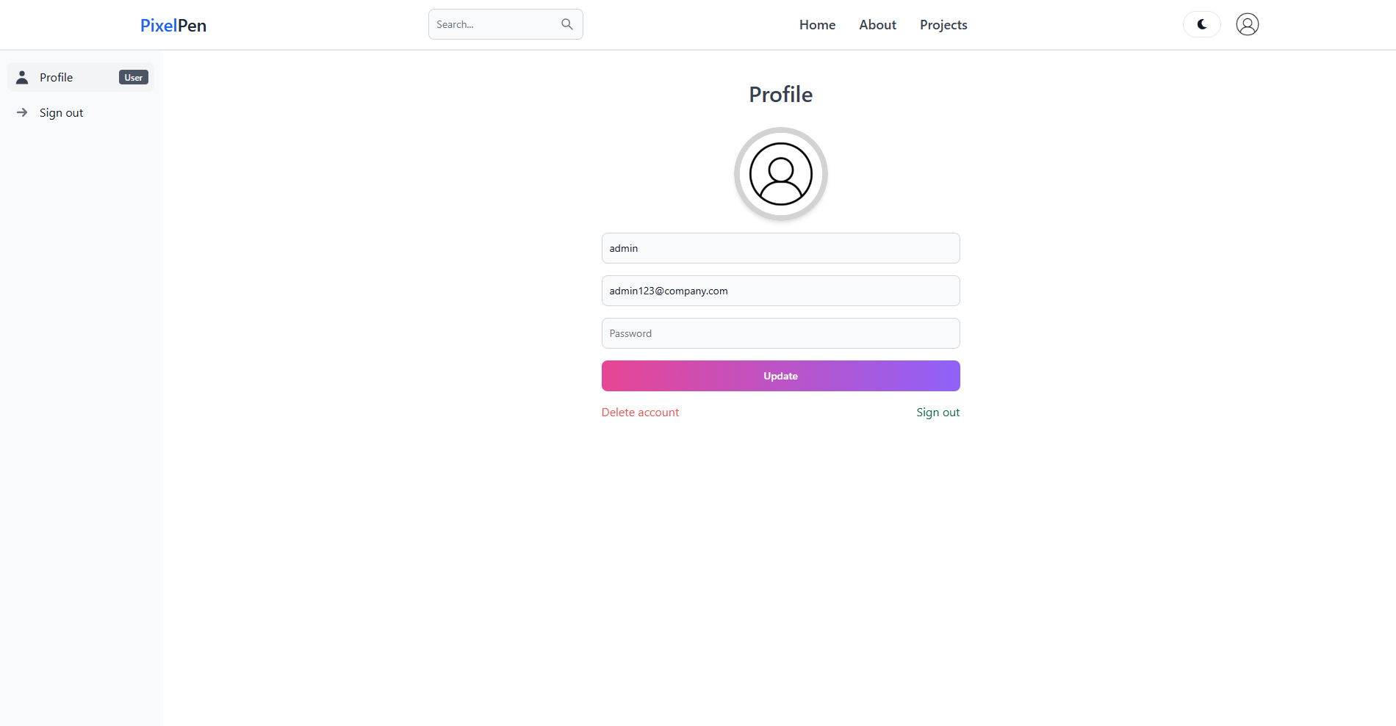
User Panel

Slide 13
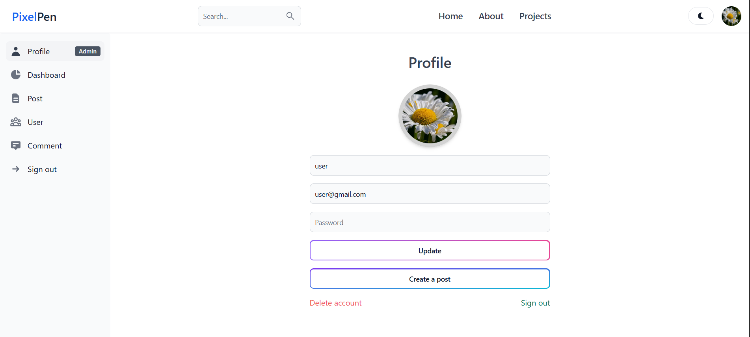
Admin Panel

Slide 14
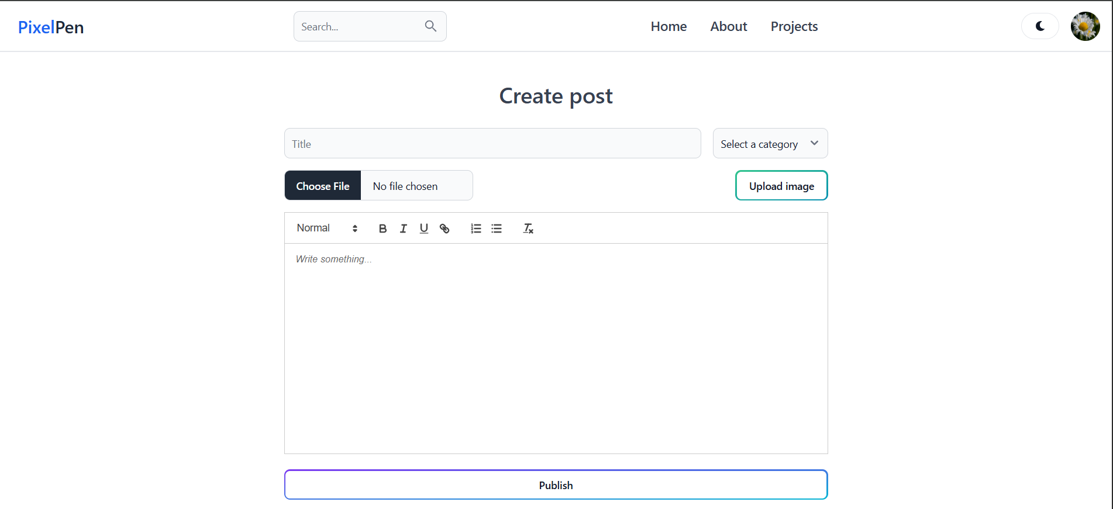
Create Post Page

Slide 15
Advantages
Modern Full-stack architecture for high performance and scalable web app.
Mobile responsive and modern UI including Dark Mode.
Rich Text Editing and Content Management for blogs.
Enhanced user engagement for more content reach.
Role-Based Access Control (RBAC) for users.
Best practises like SEO optimisation and post slug is used.
Easy to extend, modify, and customize to incorporate new features.

Slide 16
Limitations
Requires regular updates to keep with tech trends.
Scaling needs proper cloud configuration on platforms like Amazon AWS.
Steep learning curve for complete beginners wishing to contribute.
Native mobile app (iOS & Android) not yet available.
Only English language support available as of now.

Slide 17
Future Work
Develop native mobile apps (iOS & Android).
AI-powered content recommendations.
Multi-language (Internationalization) support.
Advanced analytics and SEO improvements.
Add monetization features (subscriptions, tipping).
Expansion into MultiMedia content like Video and Audio.
Enhanced content moderation and user engagement features.

Slide 18
References
Mozilla Developer Network (MDN) (2024). Express.js Documentation. Mozilla. https://developer.mozilla.org/en-US/docs/Web/JavaScript/Reference/Global_Objects/Express
MongoDB, Inc. (2024). MongoDB Official Documentation. MongoDB. https://www.mongodb.com/docs/
Stack Overflow (2024). MERN Stack Discussion Threads. Stack Overflow. https://stackoverflow.com/questions/tagged/mern-stack
Render (2025). Deploying Full-Stack Applications on Netlify. Render Docs. https://render.com/docs
Tailwind CSS (2025). Tailwind CSS with vite Documentation. https://tailwindcss.com/docs/installation/using-vite

Slide 19
Thank You.

Slide 20
Any Question? Please feel free to ask them

